Slide 1
Parch & Posey Analysis

Slide 2
Table of Content
Introduction
Project Planning and Specifications
Data Collection
Data Preparation
Data Analysis
Findings Conveying and Presentation
Project Documentation
References

Slide 3
Introduction
Scenario: I have received a business request from the Sales and Marketing in Parch and Posey containing multiple business questions.
To answer these questions, I analyzed the Parch & Posey dataset which consists of 5 csv files for the tables of orders, accounts, web events, sales representatives and regions.

Slide 4
Project Planning and Specifications
The plan for this project consists of the following stages:
Data Collection: Get the required datasets, and upload them into MS SQL Server.
Data Preparation: Transform the data as required and ready make sure it is ready for analysis
Data Analysis: Write queries using T-SQL to retrieve data using multiple conditions and methods.
Findings Conveying: Send the answers of the questions in the form of csv files (tabular form to the corresponding department.
Project Documentation:
Document the queries in a database.
Project Specifications
Database:
Parch & Posey.
Data Analysis Software:
MS SQL Server & MS Power BI
Database Management Tool:
SQL Server Management Studio
Programming Language:
T-SQL & DAX

Slide 5
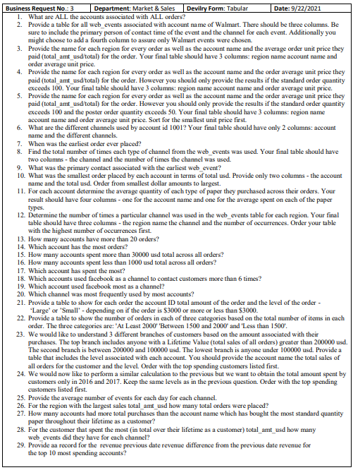
Project Planning and Specifications
Sales & Marketing Business Request

Slide 6
Data Collection

Slide 7
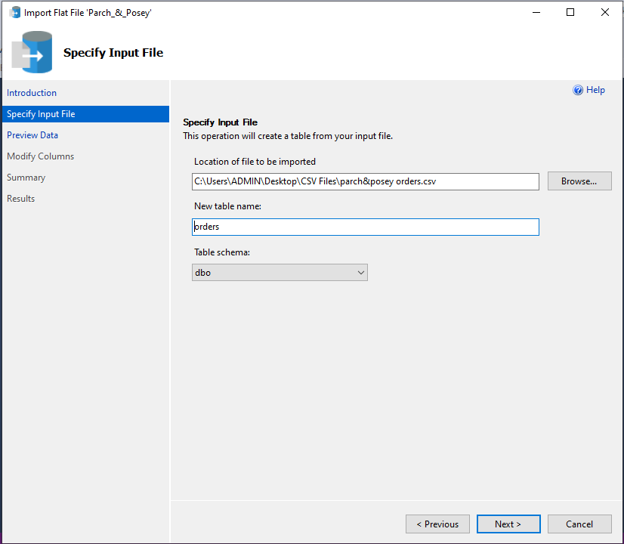
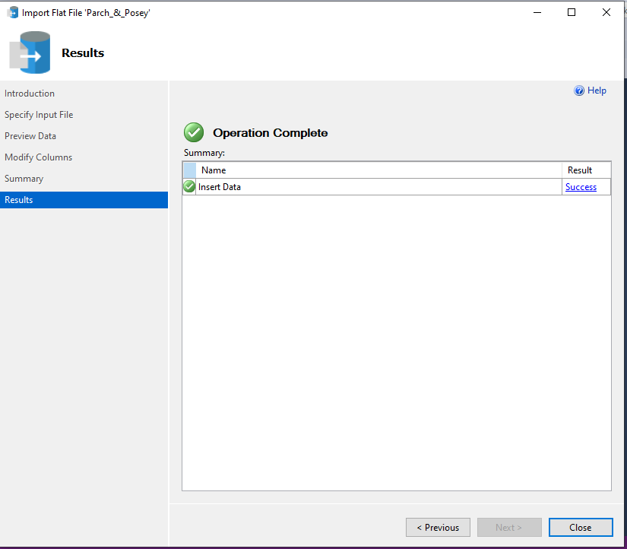
Data Collection
The data collection stage went as the following
I established the database Parch & Posey and imported the 5 csv files into it as tables using SSIS.
Examined the data within the SQL Server tables and find it is as intended.

Slide 8
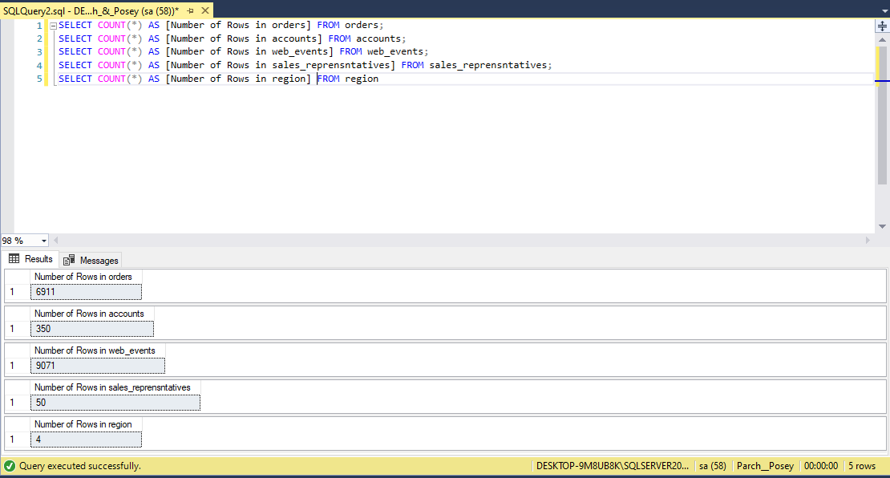
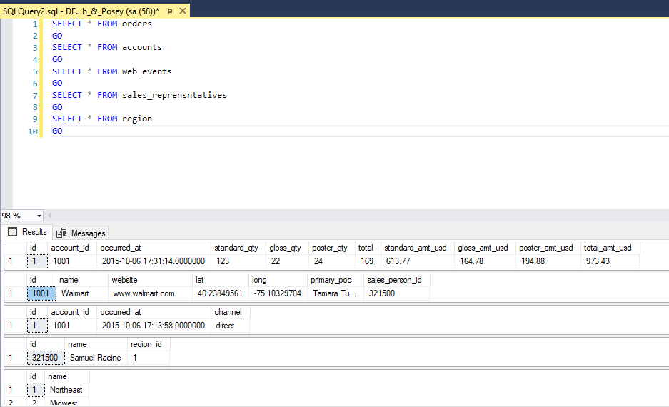
Data Collection

Slide 9
Data Preparation

Slide 10
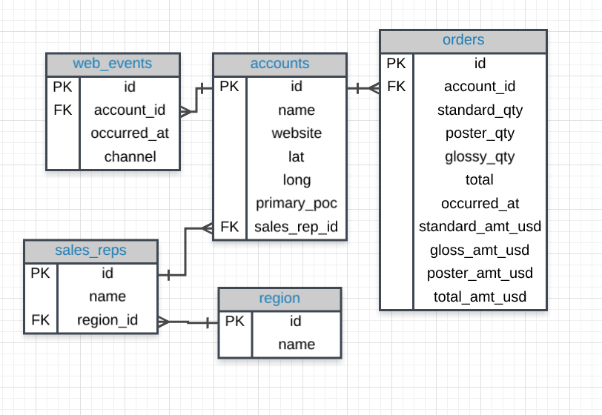
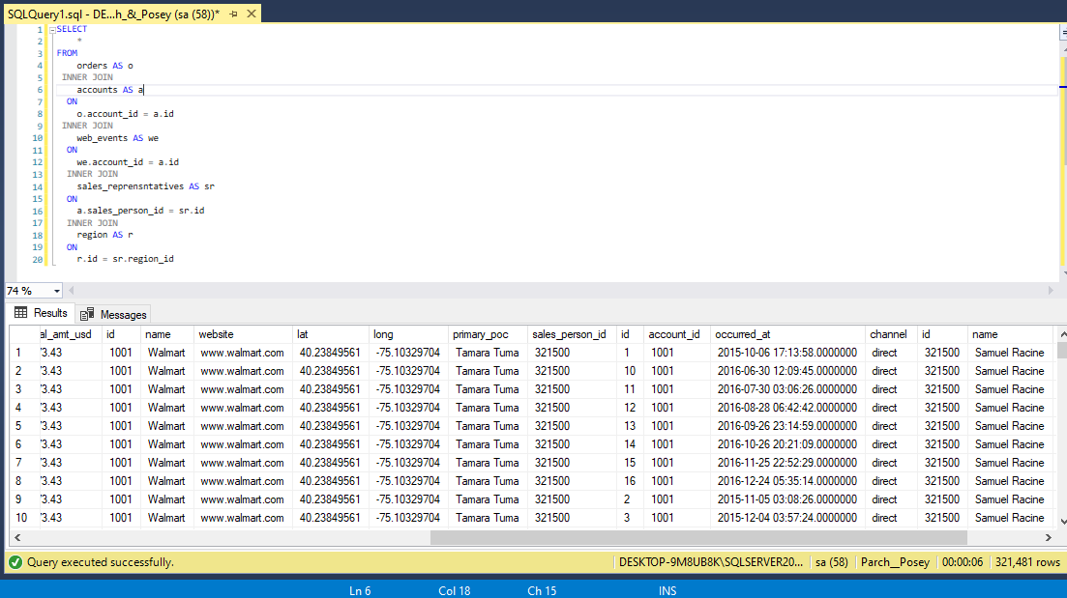
Data Preparation
In this stage, I:
Examined the relationship between the tables.
Made sure that each column is of a suitable data type.
Made sure that the data fit the analysis.

Slide 11
Data Analysis

Slide 12
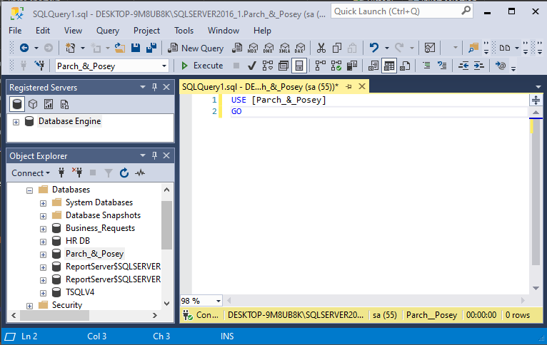
Data Analysis
In this stage, I used T-SQL and MS SQL Server Management Studio to query the tables and answer the business questions

Slide 13
Data Analysis
MS SQL Server Sub-stage
When querying the tables, I used various techniques for the analysis including:
Filtering.
Joining.
Grouping.
Sorting.
CTE & Sub-queries.
Date, Math and Text Functions.
Window Function.

Slide 14
Findings Conveying and Presentations

Slide 15
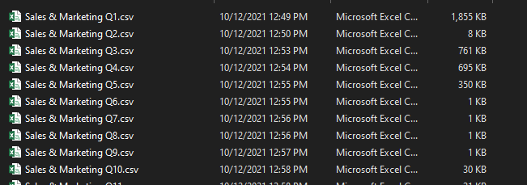
Conveying of Findings
For the SQL Server analysis queries, I forwarded the results in the form of csv file (Tabular Form).

Slide 16
Project Documentation

Slide 17
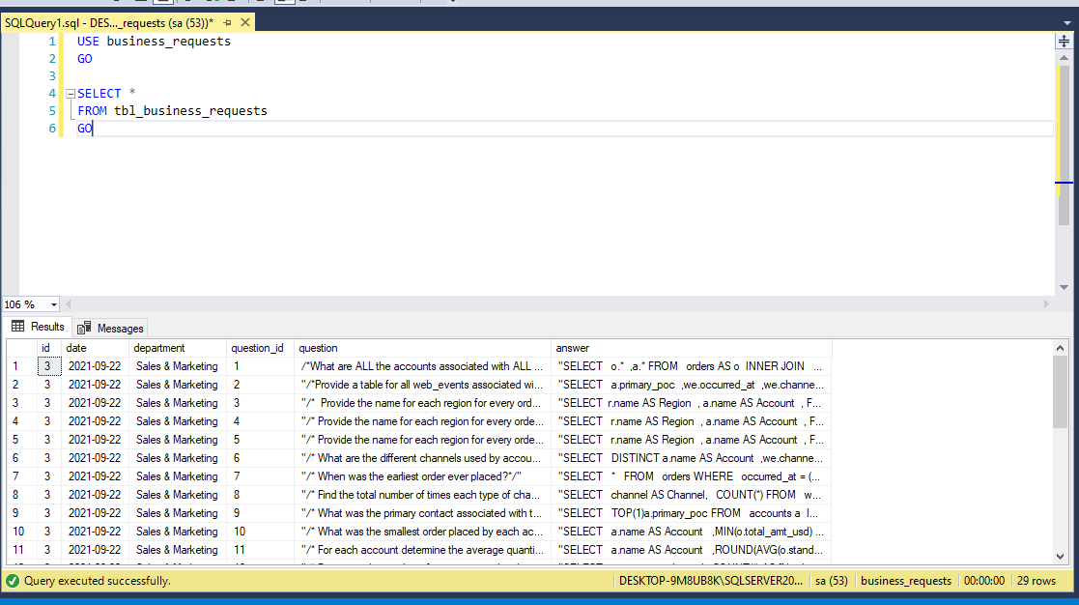
Project Documentation
I documented the project by establishing the documentation database Business Requests which is dedicated to show and document each and every question in every business request.

Slide 18
Project Documentation
Project documentation is important for mainly two reasons:
To ensure and emphasize the job responsibilities and roles.
To facilitate answering or automating the answering process if the main database is loaded incrementally and the same questions are asked regularly. For example, the data analyst can use SSIS to execute SQL Tasks that query the documentation database for certain questions and store the results in variables or flat file. Next, the data analyst can add a data flow tasks to query the main database using the results stored in a variable or flat files, then store the final results in a flat files. Next, the data analyst can add a system tasks to move the files into the desired location. This can be automated and scheduled to be executed regularly.

Slide 19
References
Project Link on GitHub:
https://git.io/JMfHh

